Slide 1
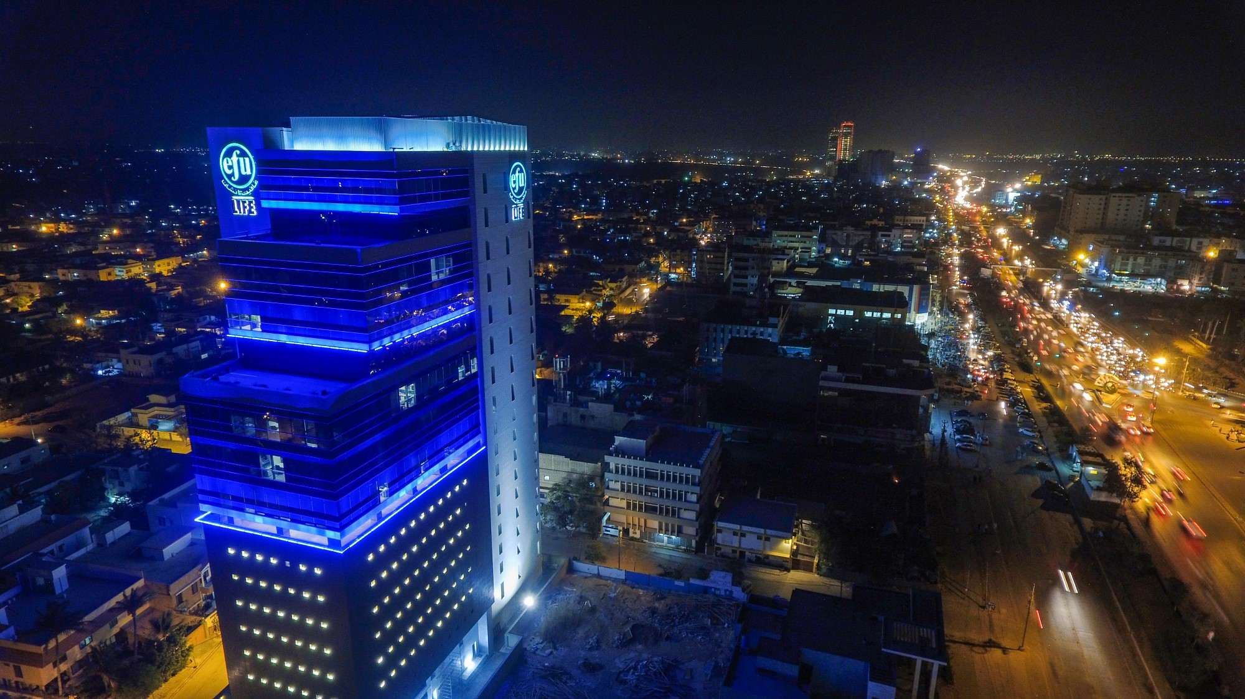
EFU Life Assurance Ltd.
2019 Analyst Briefing
Review of Company Performance and Plans for the Future
27 March 2020

Slide 2
Age
Agenda
Company Overview
Financial Highlights
Business Performance
Plans for the Future
Question and Answers

Slide 3
About EFU Life
In November 1992 EFU Life started operations as the first private sector Life Insurance Company of Pakistan
EFU’s product range offers conventional and takaful products; savings and protection
Distribution channels include Sales Force, Bancassurance, Group marketing, Alternative (telcos, MFI/MFB, digital)
Insurer Financial Strength rating of AA+ (Outlook: Stable) by VIS Credit Rating Agency
First life insurance company in Pakistan to be ISO certified; currently is ISO 9001:2015 certified
EFU Life is reinsured by leading Reinsurers in the market (Munich Re, Hannover Re)

Slide 4
Key financial indicators
5.9 Bn
Shareholders Equity
26.2%
Return on Equity
150%
Dividend
Rs. 15.49
Earnings per Share

Slide 5
Profit and Loss Account
PKR Million
 | 2019 | 2018 | Change
Gross Premium/ Contribution Revenue | 31,750 | 30,790 | 3%
Net Premium/ Contribution Revenue | 31,142 | 30,164 | 3%
Investment Income | 11,589 | 6,942 | 67%
Total Net Income | 38,062 | 30,372 | 25%
Insurance Benefits | 16,115 | 13,590 | 19%
Net Insurance Benefits | 15,677 | 13,094 | 20%
Net Change in Insurance Liabilities | 11,047 | 6,621 | 67%
Acquisition Expenses | 7,323 | 6,751 | 8%
Marketing and Administration Expenses | 1,761 | 1,603 | 10%
Total Expenses | 20,030 | 14,995 | 34%
Profit before Tax | 2,354 | 2,283 | 3%
Profit after Tax | 1,549 | 1,546 | 19 bps
Earnings per share - Rupees | 15.49 | 15.46

Slide 6
Gross Premium
15% p.a growth
In 2019, the gross premium of the Company was Rs. 31.75 billion

Slide 7
Claim Payments
In 2019, the Company settled total death and disability claims of Rs. 3.14 billion (2018: 2.71 billion), an increase of 16%

Slide 8
Assets and Funds
The net asset value of all Unit-Linked funds under management increased from Rs. 104 billion in 2018 to Rs. 114 billion in 2019, a growth of 9.6%.
The Company has a strong balance sheet size with total assets of Rs. 129.28 billion (2018: Rs. 116.76 billion)

Slide 9
Looking forward…
Challenges:
Economy, stock market
Regulatory compliance (FATF, CFT)
Lack of awareness
COVID-19
Strategy:
Focus on further building up distribution channels, increasing reach
Enhance product portfolio; focused on segments and needs
Optimize all aspects of customer journey
Technology as an enabler

Slide 10
Strategic Focal points: Market Share and Profitable Growth
Grow Value of Business
Focus on Retail through Multi-Channel Distribution
Customer Journey and Customer Centric Products
Use technology as a business enabler, a means to an end
Superior business quality to deliver enhanced customer and shareholder value

Slide 11
Thank you!

